Slide 1
My topic will be about
Cheating
In video games
Ask someone else to help you cheat, not me

Slide 2
What is cheating
The practice of modifying or exploiting video games to gain an unfair advantage
It can exist in both single-player and multiplayer games
These include glitch abuse, exploits, cheat software and mods

Slide 3
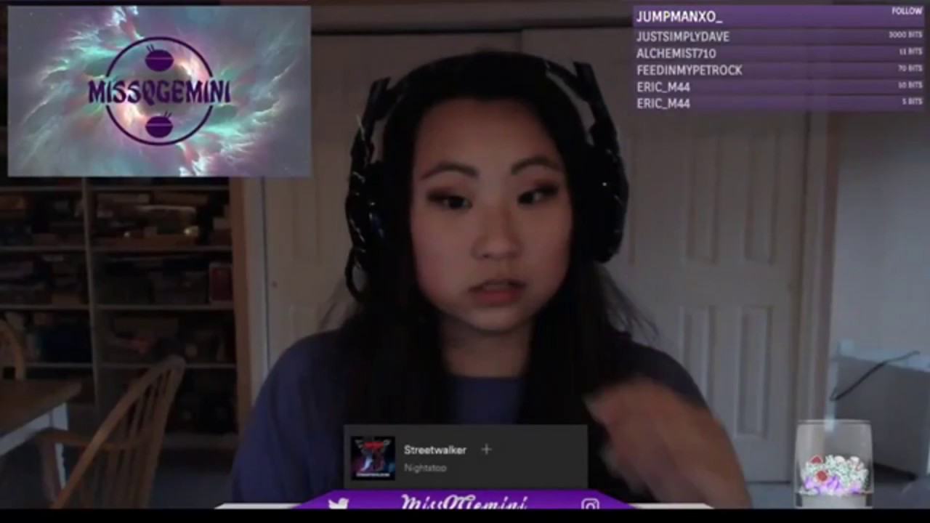
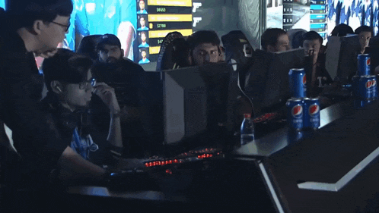
Why might people cheat
Trolling
Boosting accounts (for personal or commercial use)
Experimentation and testing the boundaries of games
Avoiding grinding
For fun
Or more commonly
Because they suck at the game 💀

Slide 4
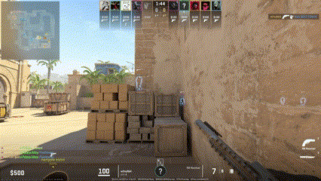
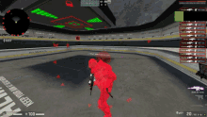
Common types of cheats
These include
Aimbots
Wall hacks and x-ray
Resource cheats such as infinite money or health
Speed and fly hacks
Lag switches
Macros: Using automated inputs especially for games like Company of Heroes and League of Legends (ew)

Slide 5



Cheat Categories- Internal cheats
Internal cheats are modifications to games allowing programs to modify game data in real time
This allows the bypassing of restrictions by manipulating code directly
Often hackers use a technique called manual mapping by inserting DLLs or Dynamic Link Libraries files into the game’s own process or memory

Slide 6



Cheat Categories- External cheats
These run separately from the game and do not directly modify the game’s executable files or memory
They are more basic in terms of features as they do not interact with the game
External cheats are more common than internal cheats

Slide 7
Other cheat Categories
DMA (Direct Memory Access) cheats use external hardware devices to read a game’s memory without accessing the systems CPU or software making them difficult to detect
VM hacking are cheats that utilise a virtual machine to prevent games from scanning the host system which could bypass hardware bans
Network manipulation cheats modify data packets allowing players to do actions such as teleport or cause lag to the game
Scripting refers to installing scripts to perform tasks

Slide 8


How are cheats made?
Memory editing tools and IDEs are downloaded such as Cheat Engine and Visual Studio
Using the memory editing tools, the memory location of variables such as health values are detected. The game may even be reversed engineered to identify how they function
The cheat is then developed depending on its type
The cheat is then tested an improved on such as evading detection
The cheats may then be distributed online (cheater.fun, wemod.com and fearlessrevolution.com)

Slide 9




What is the best defence against cheats?
Anti-cheat software is used to detect cheats running on a system
Anti-cheats scan processes by checking file integrities and flagging modules that do not belong in the game such as unknown DLL and EXE files
They may even analyse data packets being sent between the client and the server to detect abnormalities such as lag switches
Anti-cheat Software!!!!

Slide 10
How to spot a cheater
Suspicious gameplay such as unnatural movement, reaction times and high headshot and accuracy percentages
Look out for players who seem to always know your position
Players who cheat may have a high number of reports on their account
Some cheaters may even change their usernames often to avoid bans
However….
Not players who are good are cheating, it might just be a skill issue

Slide 11
(even if you’re bad)
remember don’t cheat in games

